Slide 1
Tips, tools and strategies for stakeholder engagement session with Government officials
Delia Rodrigo - Senior Regulatory Reform Expert
United States – Central Asia
Digital Trade Workshop on Stakeholder Engagement
Tbilisi, 19th of January 2023

Slide 2
Topics for discussion
What is stakeholder engagement?
Levels of engagement and its tools
Focus on the design of regulations:
Early consultation
Public consultation
Working in groups

Slide 3
What is stakeholder engagement?
Stakeholder engagement is the process by which an organization involves people who may be affected by the decisions it makes or can influence the implementation of its decisions.
Stakeholder engagement is the systematic process of identifying, analyzing, planning, prioritizing, and implementing actions intended to engage and influence stakeholders.

Slide 4
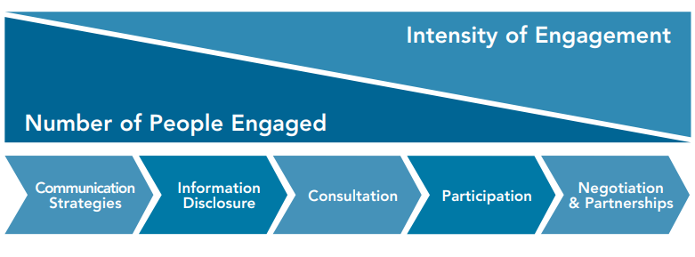
Spectrum of stakeholder engagement
Source: IFC (2007), Stakeholder Engagement: A Good Practice Handbook for Companies Doing Business in Emerging Markets, Washington

Slide 5
Levels of engagement

Slide 6
TYPES OF stakeholder engagement
Communication
Information disclosure
Consultation
Negotiation & partnerships
Grievance management
Implementation and M&E
Source: Based on IFC (2007), Stakeholder Engagement: A Good Practice Handbook for Companies Doing Business in Emerging Markets, Washington

Slide 7
how do we engage AT those different levels? Variety of tools
Informal meetings
Website and social media
Public consultation
Working/technical groups
Surveys/questionnaires/polls
Deliberation fora
Experimental projects

Slide 8
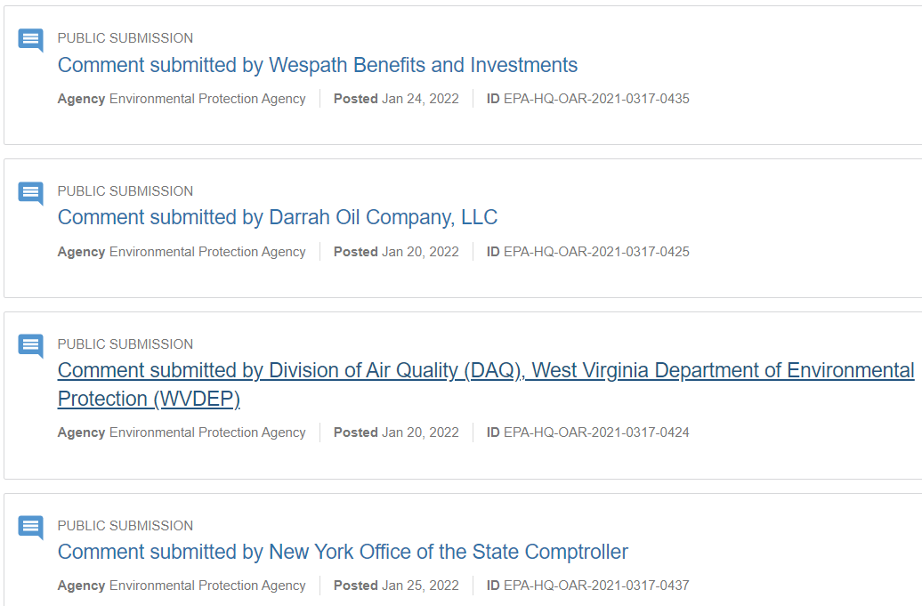
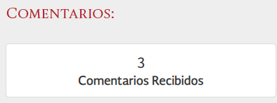
Example: We have an official platform to provide comments to draft regulations

Slide 9
Good practices in the use of tools for stakeholder engagement
Use stakeholder mapping and analysis to define the best tools to use
Start as soon as possible and plan ahead
Have flexibility to adapt the tools to the issue to be addressed
Combine the tools, as all have pros and cons
Use the tools to get the information and data you need
Ensure transparency and communicate correctly

Slide 10
When engaging with stakeholders take into consideration….
How to manage the interests of stakeholders?
Balancing interests is fundamental
What are necessary capacities to handle stakeholder engagement?
What is the information you require from stakeholders?
Be precise, and target your efforts to get the required information
What are the capacities in the administration to deal with stakeholder engagement and be consistent over time?
What are the costs associated with the whole process?
Engagement takes time and resources for all participants
How to handle influence?
Stakeholders would like to influence decision-making, you need to handle that carefully
Avoid consultation fatigue

Slide 11
The regulatory process
Regulatory Impact Analysis (RIA) and early consultation
Drafting process and formal public consultation
Identifying
The problem to be solved and what government wants to achieve (objectives)
Looking
For options to solve the problem
Analyzing
The impacts of the problem on stakeholders
Taking
Decision on how to address the problem and how to implement the solution
Preparing
The solution (e.g., drafting the regulation)
Publicizing
The solution (e.g., the proposed regulation)
Adopting
The regulation

Slide 12
Conducting regulatory impact assessment (RIA) to support decision-making
RIA is a key tool to improve regulatory quality
RIA helps get better decisions based on evidence
You should guide stakeholders on the type of information required for this purpose:
Organize properly and start as early as possible
Define the key moments of the process where data and information are key
Engage with stakeholders in various forms to obtain data and information
Communicate effectively and provide feedback to stakeholders

Slide 13
How to conduct constructive and effective stakeholder engagement?
Organization, planning and prioritization matter
Communication is essential
Be consistent with your approach and tools
Flexibility to adapt to the type of engagement and needs
Manage interests and influence carefully
Monitor participation
Build trust along the process

Slide 14
Let´s work in groups
Our Government is planning to regulate cybersecurity/e-signatures/e-transactions (choose one of them!). The private sector has different concerns about this issue, and proposes to engage at early stages of the process
Please work in a group to address the following issues:
The private sector has various concerns and wants to influence the process.
The private sector asks the Government to set up a Working Group
Which stakeholders should be part of that Working Group? Please prepare a stakeholder mapping
You receive a suggestion to use the following tools to interact with stakeholders: questionnaires, focus groups and pilot projects. What would be your strategy to ensure their use?

Slide 15
Let´s work in groups
There is in our country an obligation to conduct public consultation for 15 days on draft regulations
Please elaborate a plan to ensure this is a successful process
What are the challenges and bottlenecks you identify in using these mechanisms? Use your personal experienced based on current practices in your country

Slide 16
Thank you!
drodrigo@alliorodrigo.com

