Slide 1
Digital Trade Working Group

Slide 2
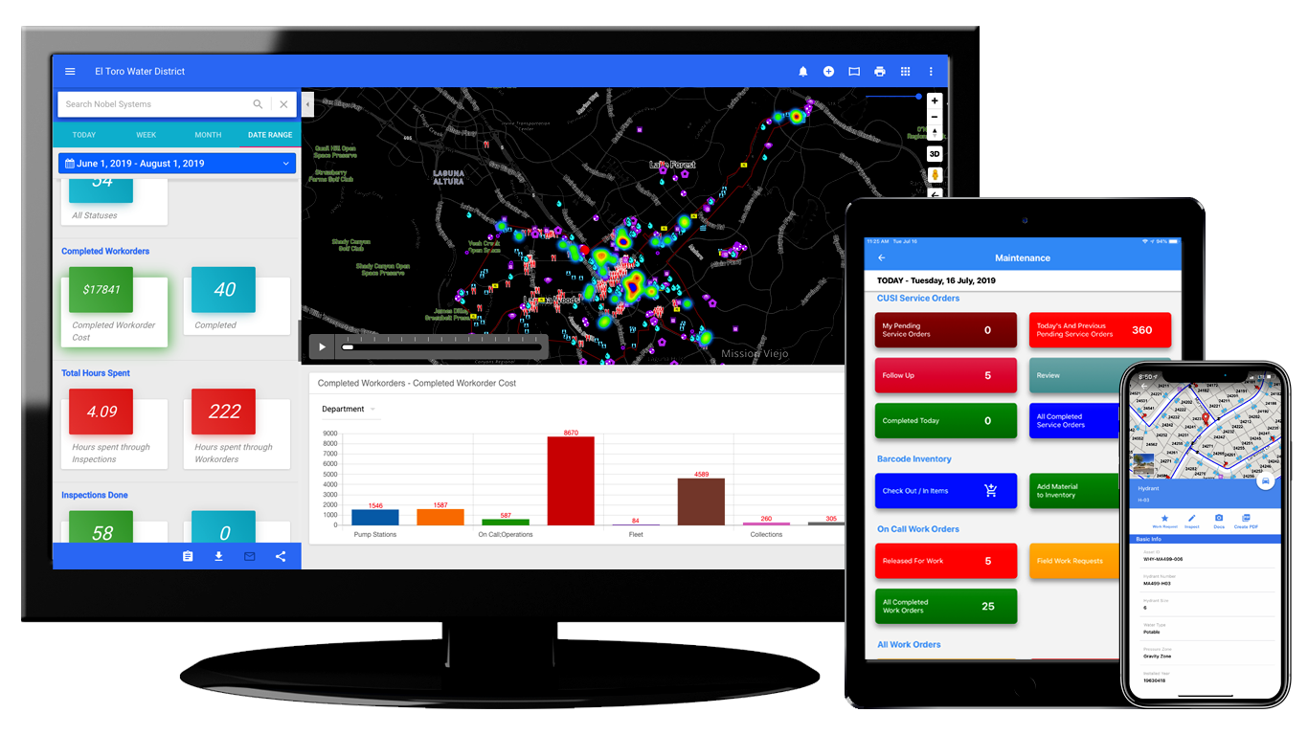
Company Overview
Cloud-hosted Enterprise Asset Management & Geographic Information System (GIS)
A subscription-based mapping system for dynamic visualization, geospatial data management and analysis.
Founded in 1992, and headquartered in Redlands, California
Clients across the world with thousands of users
More than 25 years working in the water industry
Leader in water industry technology

Slide 3
The Digital Twin Solution
Digital Twins hosted on the Cloud help water utilities to not only better understand past and current performance of their water systems, but also predict and optimize future performance. They simulate any potential changes and their impact in the virtual world before they occur in the physical world. This level of helps utilities make quick, data-driven decisions, and helps them respond in the best way to crises and other what-if scenarios.
Example of a Digital Twin in action at our customer in the US
https://www.youtube.com/watch?v=b5F9fiLXVcM&t=1s

Slide 4
Global Customer Base
USA
The Philippines
Czech Republic
Nepal
Uzbekistan

Slide 5
Nobel’s Territory
USA – Several Customers across the Country
Philippines - Several Customers across the Country
The Philippines follows the US model, and both the US and the Philippines are very transparent and open. The Philippines also has a well set up grievance and auditing mechanism
Czech Republic – Our solution is GDPR compliant
Nepal – New customer and funded by ADB

Slide 6
Uzbekistan
Project Details
Nobel was awarded a Cloud Hosted Digital Twin Solution by UzSuvTaminot, the Country’s water utility company
Project funded through a grant from the US Trade & Development Agency

Slide 7
Challenges
Cloud Hosting is not allowed by the State Security Agency and the Ministry of Finance, even though the ICT ministry approved it
Nobel Systems never stores Personal/ Private Data on the Cloud
Project is on hold

Slide 8
Thank you
MICHAEL SAMUEL – President
michael@nobel-systems.com
Mobile: +1 951 3178941
ARETHA SAMUEL – CTO
arethasamuel@nobel-systems.com
Mobile: +1 909 6776841

